Slide 1
Random Forests™
Ensembles of bootstrapped, weakened trees
Terence Parr
MSDS program University of San Francisco

Slide 2
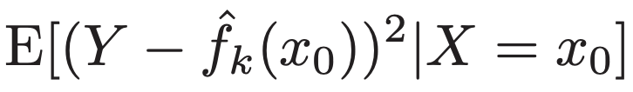

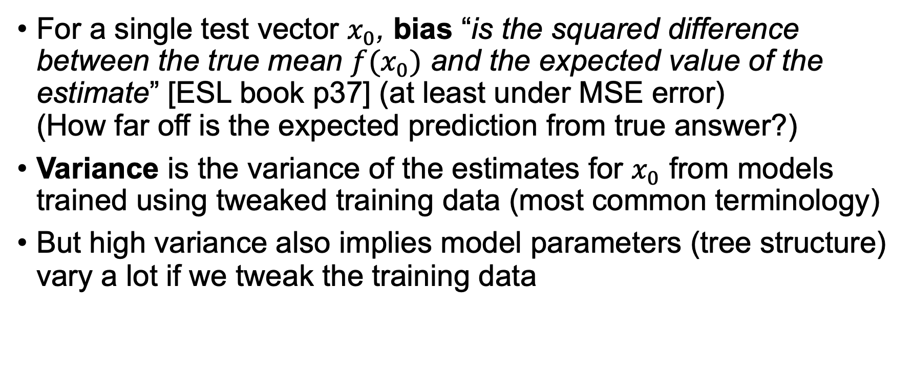
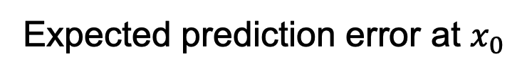
Bias / Variance (again)
Expected prediction error at $x_{0}$
For a single test vector $x_{0}$, bias “is the squared difference between the true mean $f(x_{0})$ and the expected value of the estimate” [ESL book p37] (at least under MSE error) (How far off is the expected prediction from true answer?)
Variance is the variance of the estimates for $x_{0}$ from models trained using tweaked training data (most common terminology)
But high variance also implies model parameters (tree structure) vary a lot if we tweak the training data
Unbiased but high variance

Slide 3
RF motivation
Leo Breiman (1996) introduced bagging
then Random Forests (2001)
https://www.stat.berkeley.edu/~breiman/randomforest2001.pdf
Decision trees can often get training errors close to zero because we can grow very large trees to partition the feature space into tiny regions with 1 or just a few observations / samples; trees are very accurate on the training set and have low bias
The downside is that decision trees overfit like mad: decision trees have high variance and don’t generalize well

Slide 4
Analogy: Decision tree SF house prices
Real estate agent builds house price model in their head by visiting lots of houses in SF
Increase generality by averaging, say, all houses in each neighborhood: averaging smooths out variation in answers (shortening tree or increase node size)
The cost: less precise house predictions
Hmm…can we think of another way to average w/o introducing bias?

Slide 5
How can we increase generality?
Goal: keep the high accuracy, but increase the generality
So, let’s alter our decision tree model in a way that makes predictions noisier but with same prediction expected value (don’t intro any bias)
To compensate for the noise and claw back some accuracy, make an ensemble of such trees; ensemble predicts average or majority vote of trees
Averaging predictions reduces variance without introducing bias so ensemble is accurate on average
The expected value of full strength model is same as expectation of altered model's prediction
Target image credit: http://ficscience.blogspot.com/2011/02/technicalities-of-technical-terms.html

Slide 6

The key trick is amnesia
Random forests are all about adding a bit of amnesia to the training process
We will weaken trees by training each on a randomly selected subset of the training data: bagged trees
Further, we will have training purposely forget about some features as we create decision nodes: random forests

Slide 7
Analogy: Crowdsourcing SF house prices
Recruit multiple real estate agents to build house price models in their heads by visiting lots of houses; then each agent can estimate prices of unvisited houses
Agents choose and examine house subsets independently
There will be some overlap in visited houses sets but the subsets will be independent and identically distributed (i.i.d.)
An agent trained on an i.i.d. subset is not biased (they have same expectation) but is less accurate—a prediction for one house might be too low but a prediction for another house might be too high
The variance of the ensemble average will be much tighter than the variance of an individual tree's prediction
Averaging all agents’ predictions reduces variance and is unbiased

Slide 8
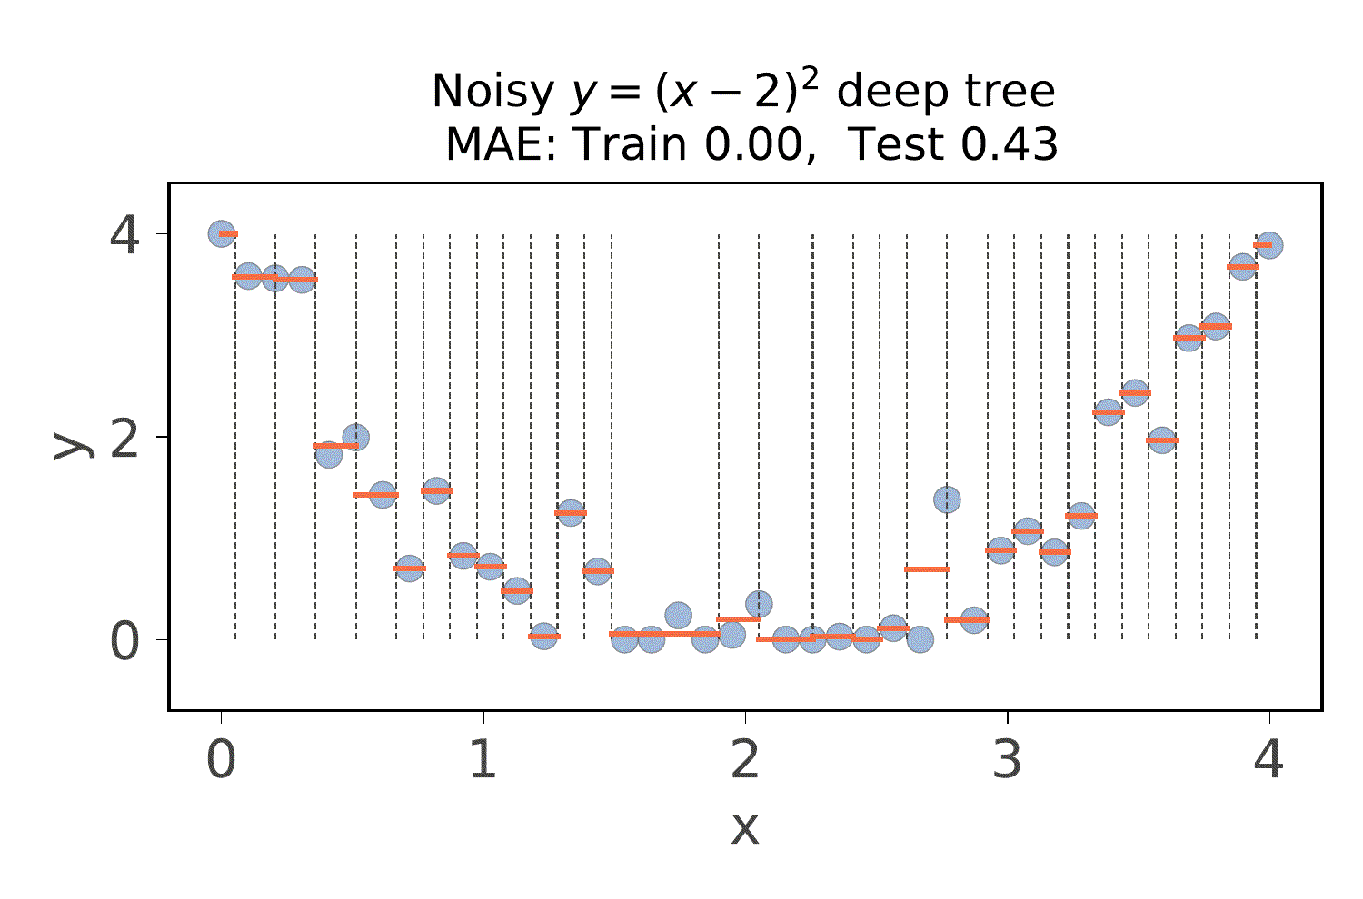
Ex: Overfit decision trees regressors
Uh oh!
Animation shows 1D feature space partitioning of i.i.d. sample sets
Slightly different training data sets can yield very different decision trees
Clearly the trees have gotten way too specific to the data set
Notice how the training error is 0 but (20% hold out) test error is terrible!
See https://github.com/parrt/msds621/blob/master/notebooks/trees/random-forests.ipynb

Slide 9
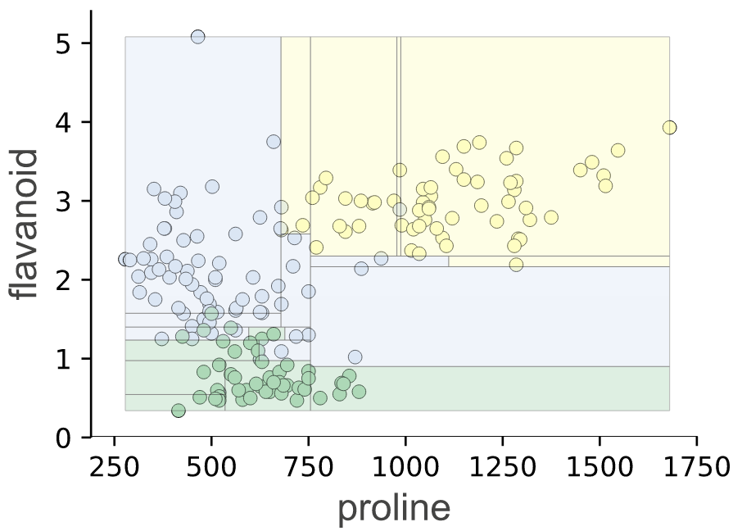
Ex: Overfit decision tree classifiers
unlikely to be general
Here is a previous example where partitioning trapped a lonely blue in a sea of yellow
In practice, we're given just one data set so let's do some sampling to get some i.i.d. "copies"
Then see how different data sets give different partitioning (from different trees)

Slide 10
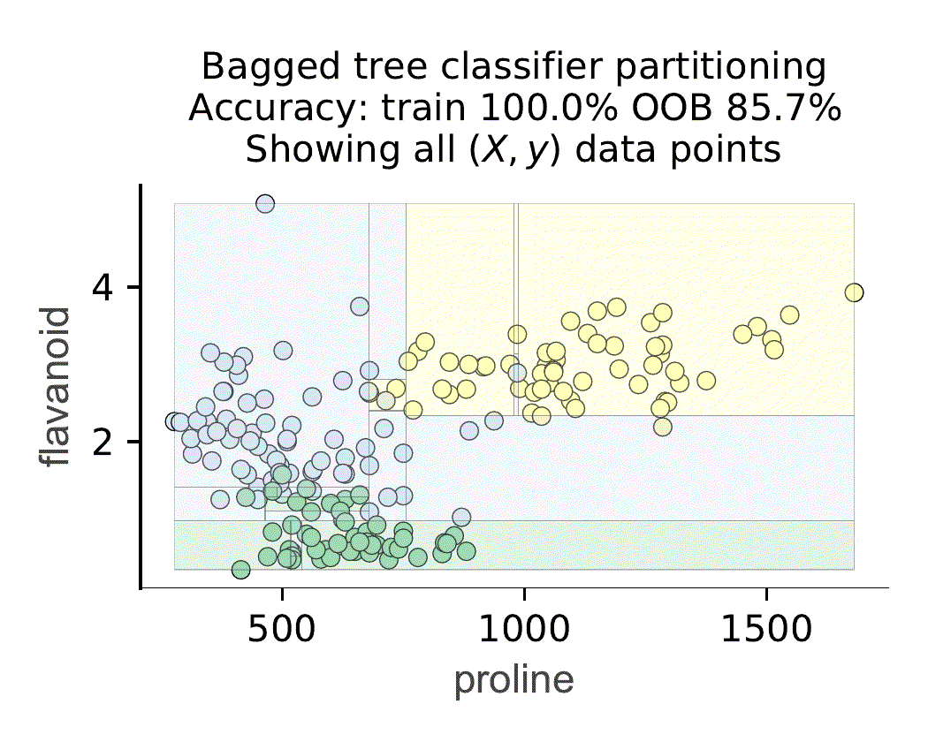
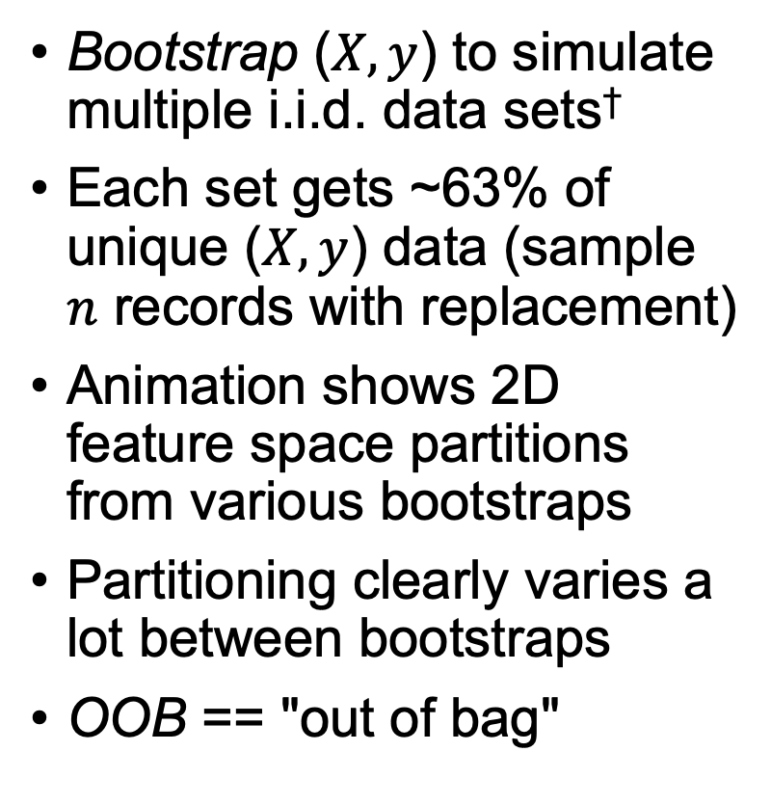
Partitioning from bootstrapped data
†
Uh oh!
Varies
Bootstrap ($X,y$) to simulate multiple i.i.d. data sets†
Each set gets ~63% of unique ($X,y$) data (sample $n$ records with replacement)
Animation shows 2D feature space partitions from various bootstraps
Partitioning clearly varies a lot between bootstraps
OOB == "out of bag"
amnesia
(more later)
†Bootstraps are technically conditionally independent, conditioned on nature of original $X$, which could be weird by chance or by the way it was collected/obtained.

Slide 11
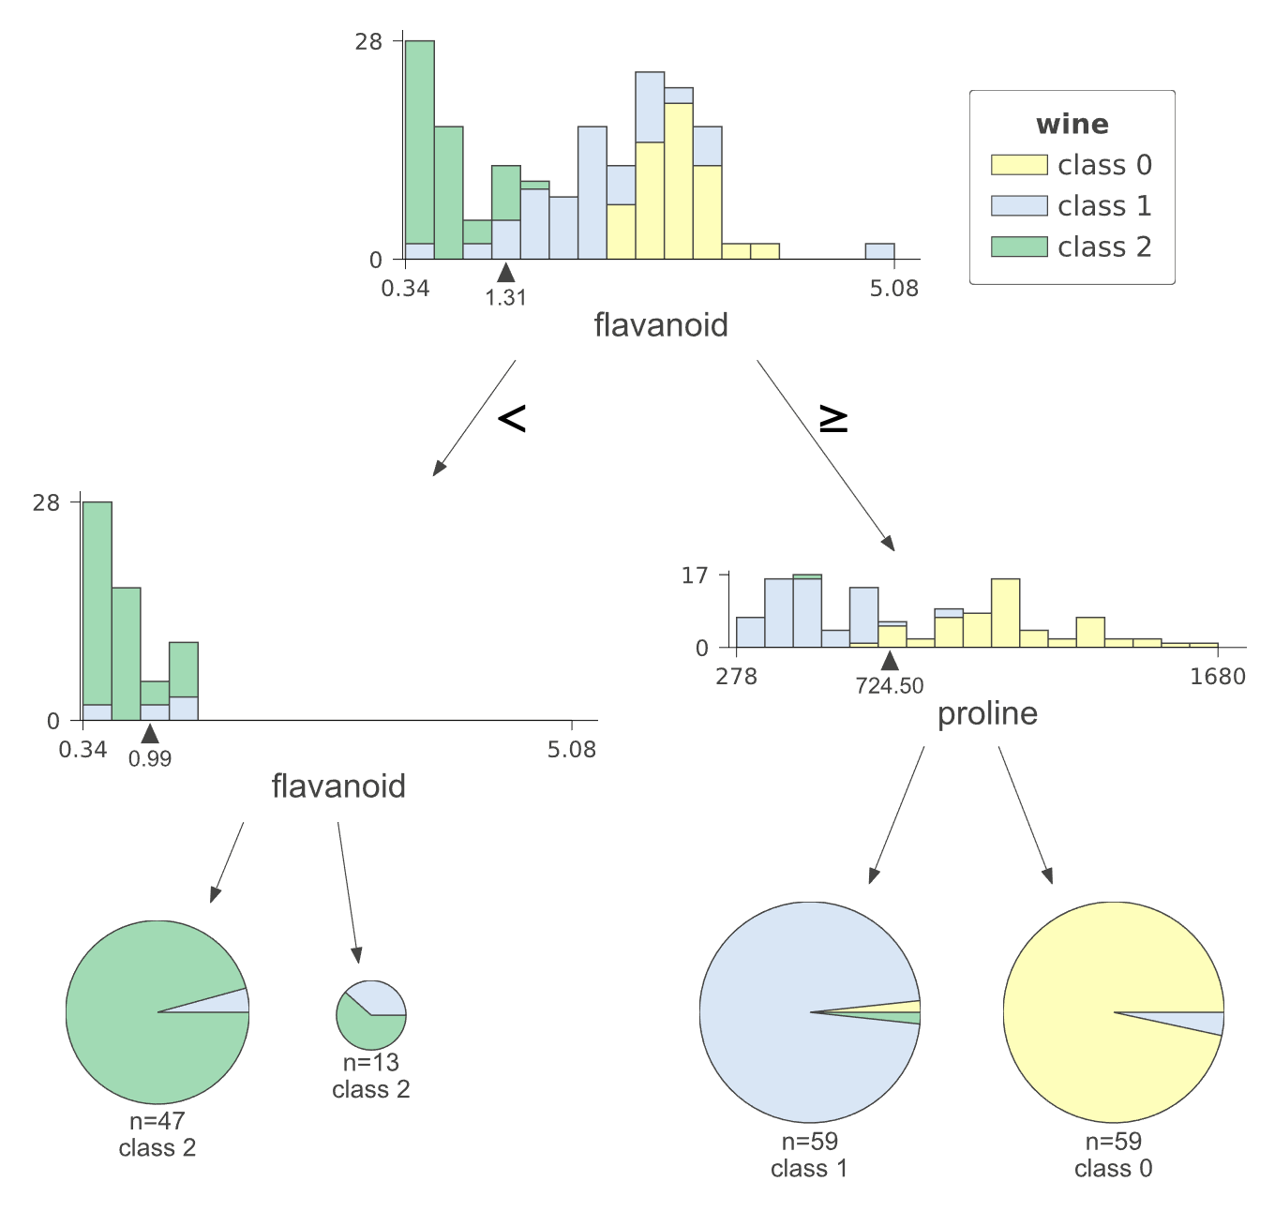
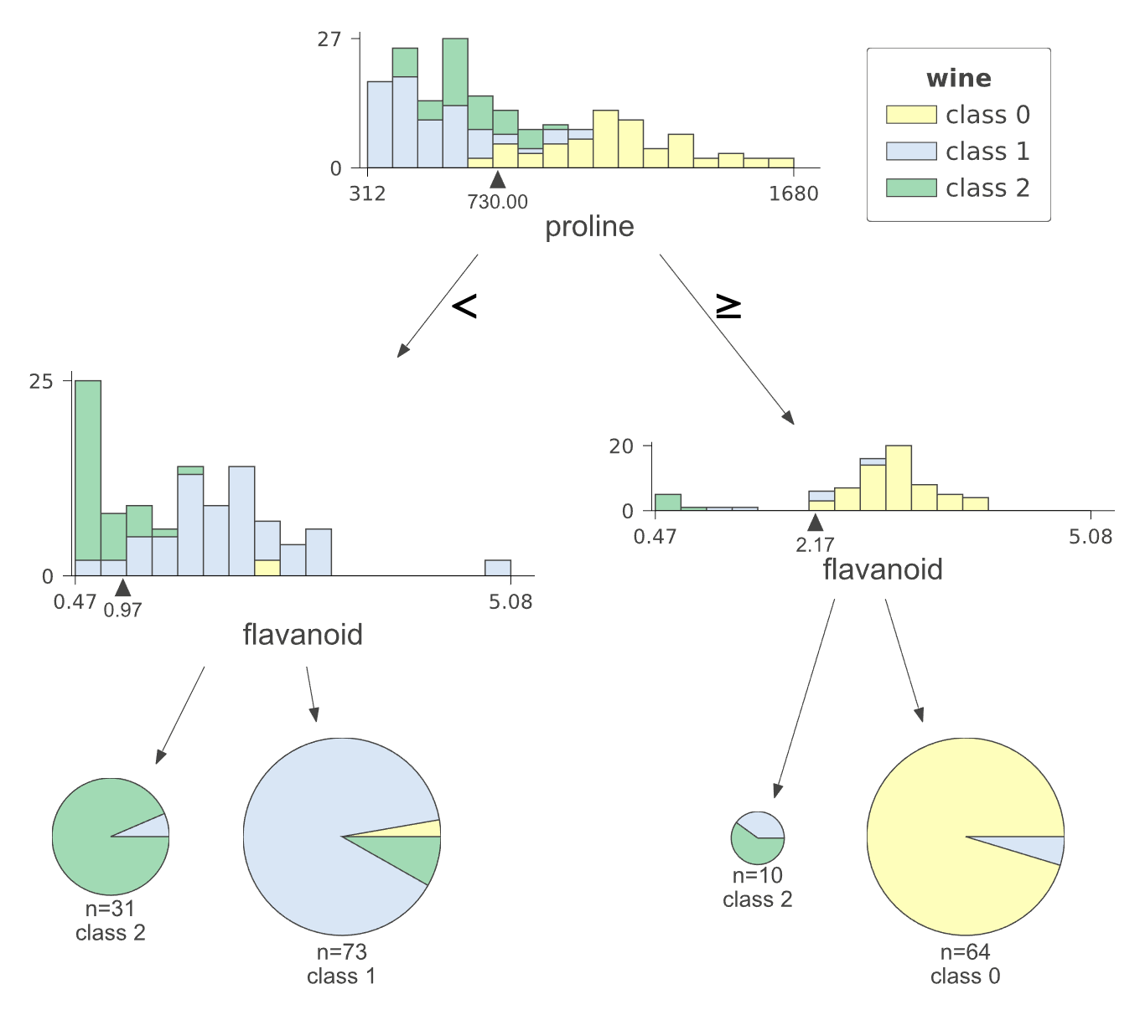
Bootstrapping gives slightly different trees
DecisionTreeClassifier(max_depth=2)
Same tree construction algorithm running on slightly different bootstraps

Slide 12
Aside: Code for bootstrapping
NumPy
# Bootstrap: sample with replacement n = len(y) idx = np.random.randint(0,n,size=n) X_train = X[idx] y_train = y[idx]
# get OOB (out-of-bag) samples mask = np.ones(n, dtype=bool) mask[idx] = False X_test = X[mask] y_test = y[mask]
Pandas
# If data in dataframe
df = df.sample(len(df), replace=True)
See https://github.com/parrt/msds621/blob/master/notebooks/trees/random-forests.ipynb

Slide 13
Bagged trees
Training trees on bootstrapped samples and aggregating predictions

Slide 14
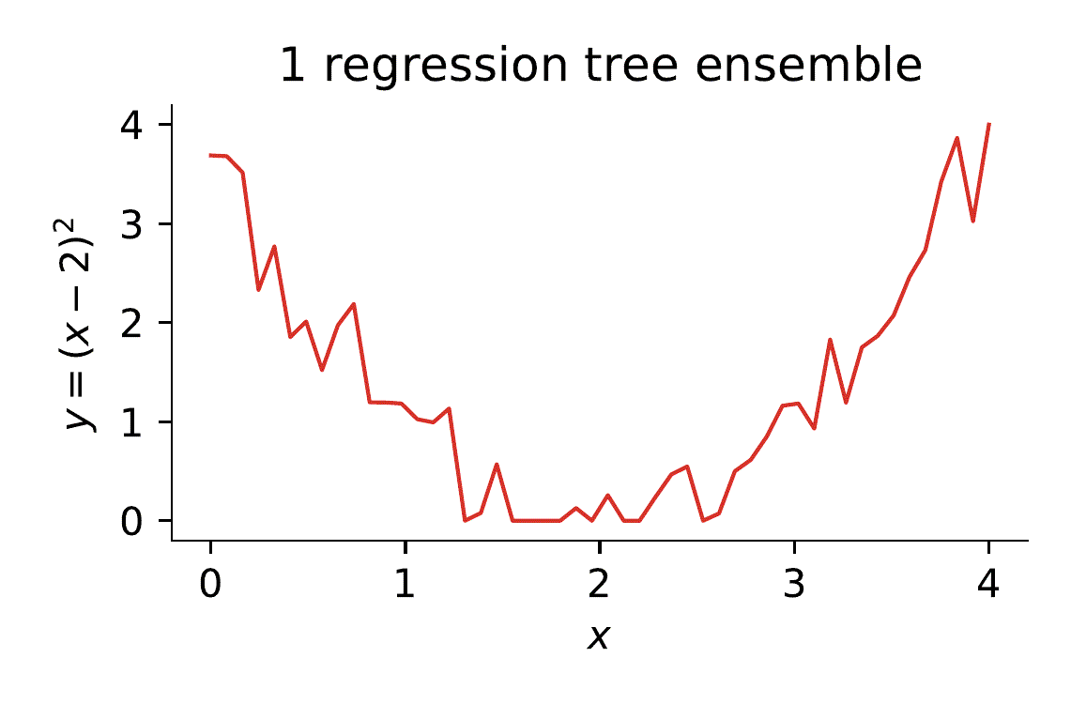
Ensemble of high-variance regression trees
Animation shows how averaging the prediction of an ensemble of overfit trees actually produces a reasonable combined prediction
As we add trees, the average prediction (red line) smooths out to reveal the underlying quadratic distribution from which we draw noisy samples
Note: variance of individual tree predictions stays high regardless of number of trees, but the variance of the ensemble average tightens (the magic of C.L.T.)
Repeatedly drawing new noisy training sets

Slide 15
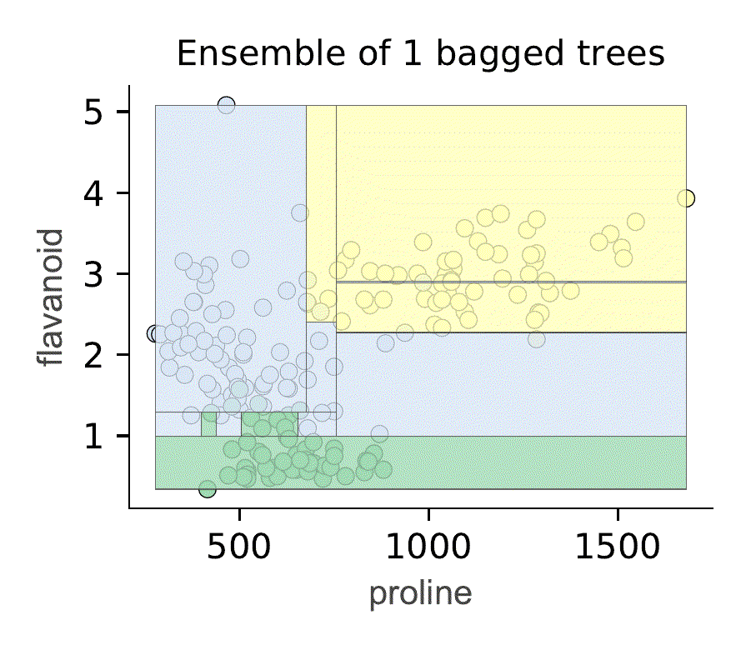
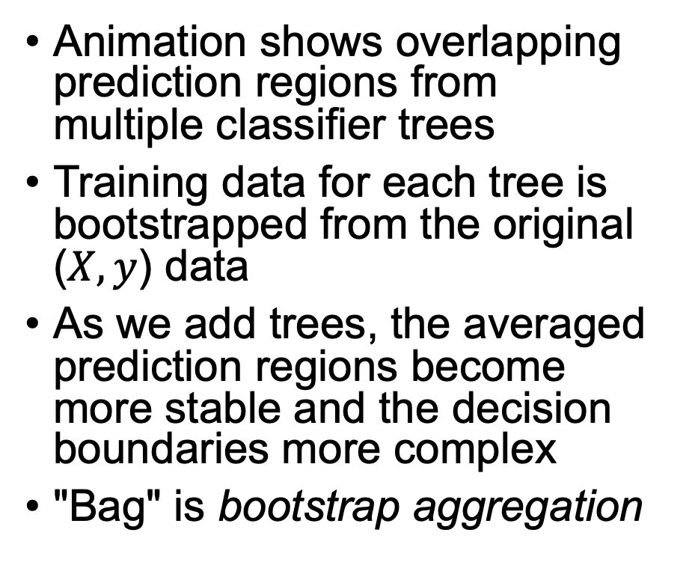
Ensemble of high-var. classification trees
Animation shows overlapping prediction regions from multiple classifier trees
Training data for each tree is bootstrapped from the original ($X,y$) data
As we add trees, the averaged prediction regions become more stable and the decision boundaries more complex
"Bag" is bootstrap aggregation

Slide 16
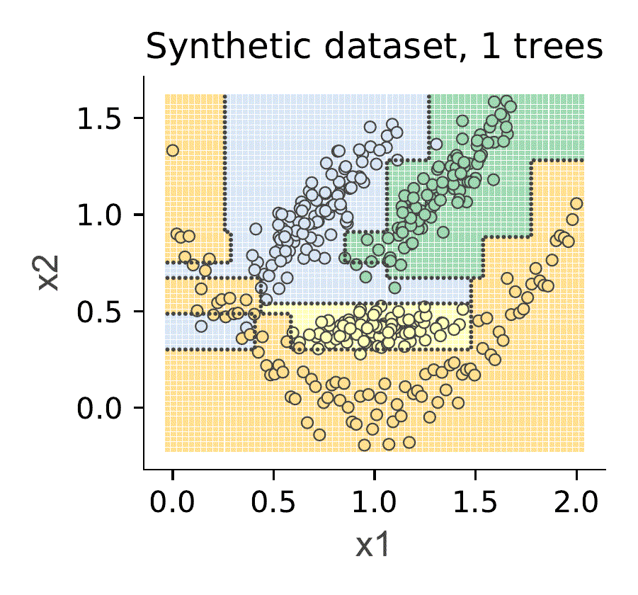
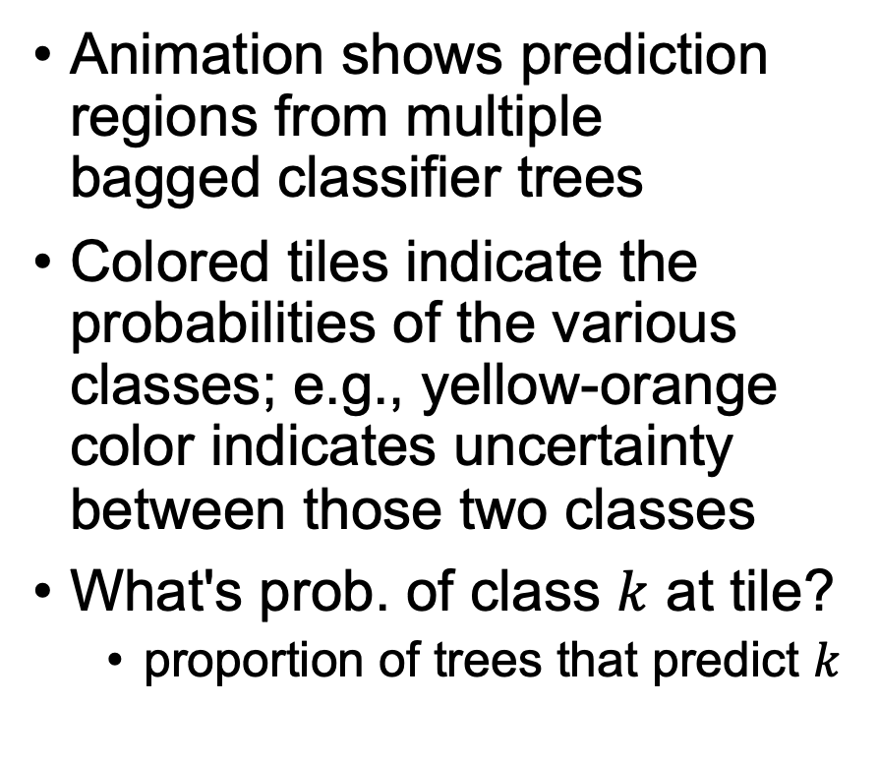
Ensemble classifier on synthetic data set
Animation shows prediction regions from multiple bagged classifier trees
Colored tiles indicate the probabilities of the various classes; e.g., yellow-orange color indicates uncertainty between those two classes
What's prob. of class $k$ at tile?
proportion of trees that predict $k$
Animation uses probability space visualization I added to dtreeviz

Slide 17
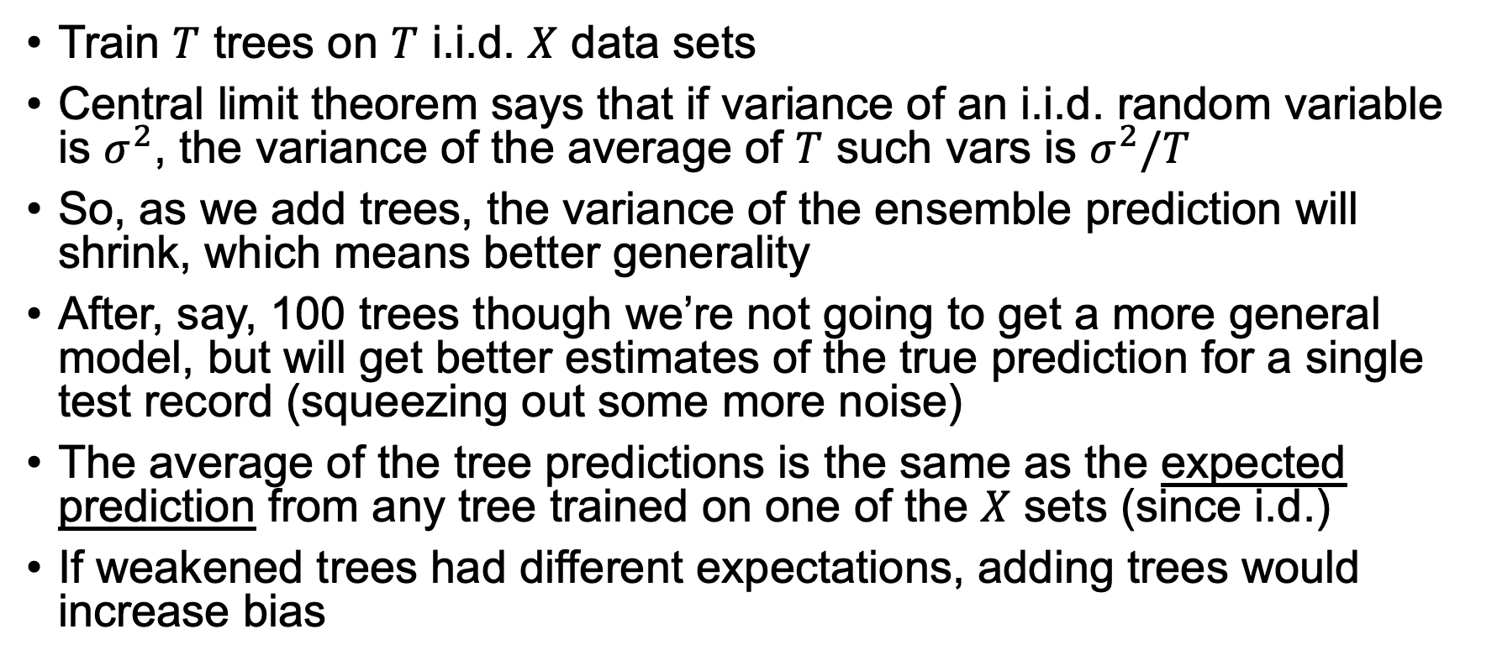
Ensemble’s effect on bias and variance
Train $T$ trees on $T$ i.i.d. $X$ data sets
Central limit theorem says that if variance of an i.i.d. random variable is ${\text{σ}}^{2}$, the variance of the average of $T$ such vars is ${\text{σ}}^{2}/T$
So, as we add trees, the variance of the ensemble prediction will shrink, which means better generality
After, say, 100 trees though we’re not going to get a more general model, but will get better estimates of the true prediction for a single test record (squeezing out some more noise)
The average of the tree predictions is the same as the expected prediction from any tree trained on one of the $X$ sets (since i.d.)
If weakened trees had different expectations, adding trees would increase bias
See page 588 ESLII book

Slide 18
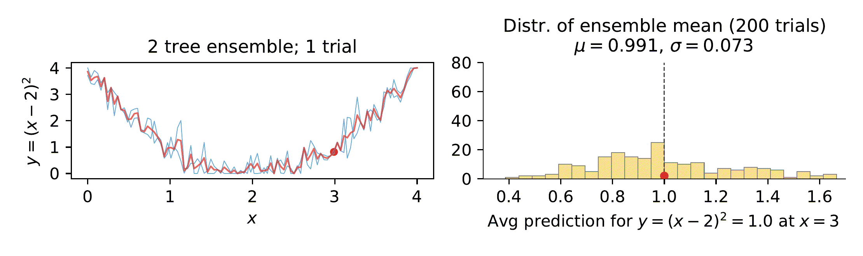
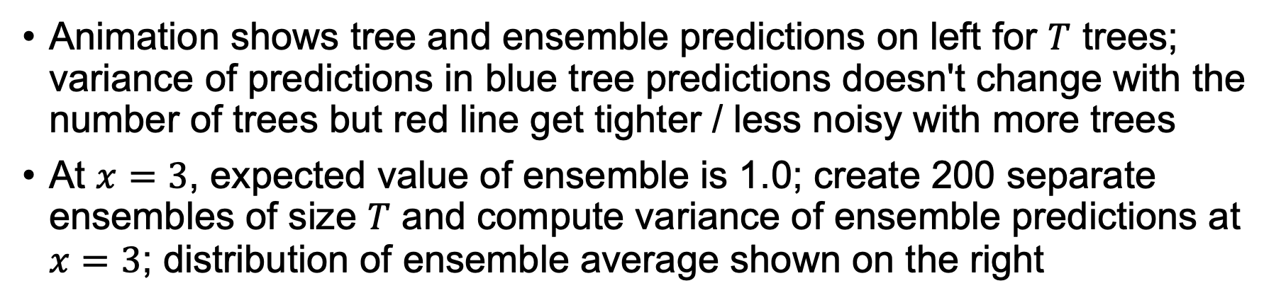
Ex: variance of ensemble prediction
Animation shows tree and ensemble predictions on left for $T$ trees; variance of predictions in blue tree predictions doesn't change with the number of trees but red line get tighter / less noisy with more trees
At $x=3$, expected value of ensemble is 1.0; create 200 separate ensembles of size $T$ and compute variance of ensemble predictions at $x=3$; distribution of ensemble average shown on the right
(Dashed line shows expected value)
See https://github.com/parrt/msds621/blob/master/notebooks/trees/random-forests.ipynb

Slide 19
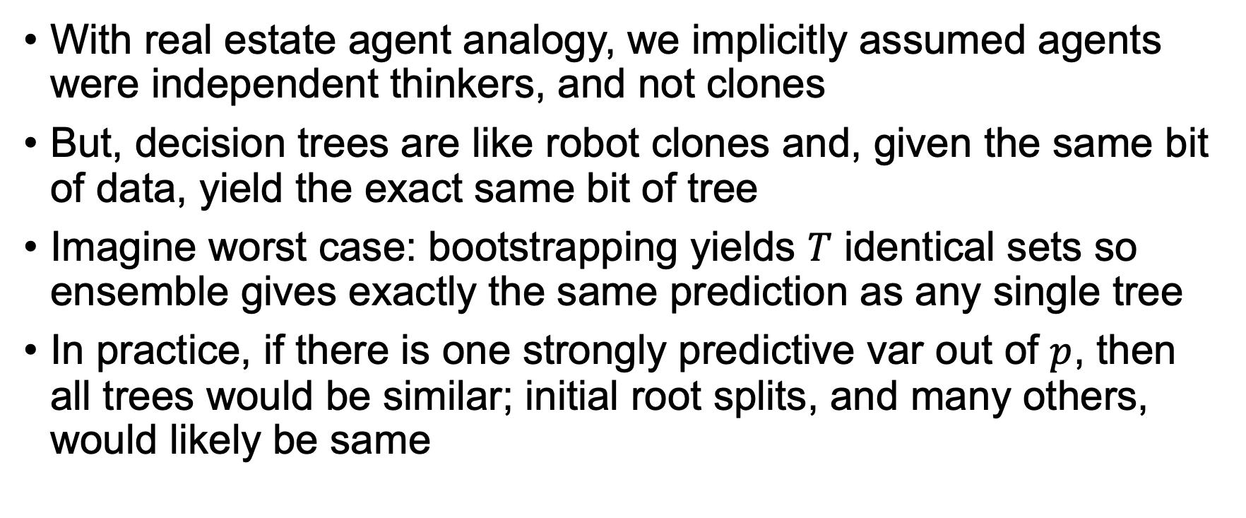
Problem: trees are not independent thinkers
With real estate agent analogy, we implicitly assumed agents were independent thinkers, and not clones
But, decision trees are like robot clones and, given the same bit of data, yield the exact same bit of tree
Imagine worst case: bootstrapping yields $T$ identical sets so ensemble gives exactly the same prediction as any single tree
In practice, if there is one strongly predictive var out of $p$, then all trees would be similar; initial root splits, and many others, would likely be same

Slide 20
Random Forests
Ensembles of de-correlated bagged trees

Slide 21
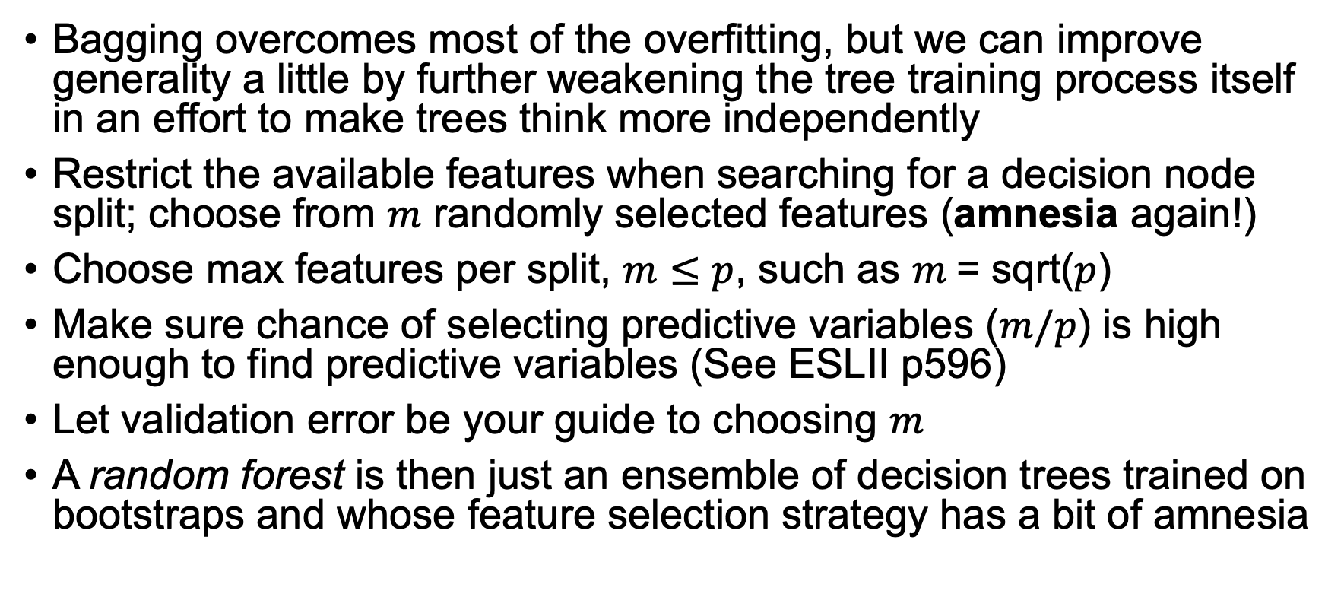
Making trees independent thinkers
Bagging overcomes most of the overfitting, but we can improve generality a little by further weakening the tree training process itself in an effort to make trees think more independently
Restrict the available features when searching for a decision node split; choose from $m$ randomly selected features (amnesia again!)
Choose max features per split, $m≤p$, such as $m$= sqrt($p$)
Make sure chance of selecting predictive variables ($m/p$) is high enough to find predictive variables (See ESLII p596)
Let validation error be your guide to choosing $m$
A random forest is then just an ensemble of decision trees trained on bootstraps and whose feature selection strategy has a bit of amnesia

Slide 22
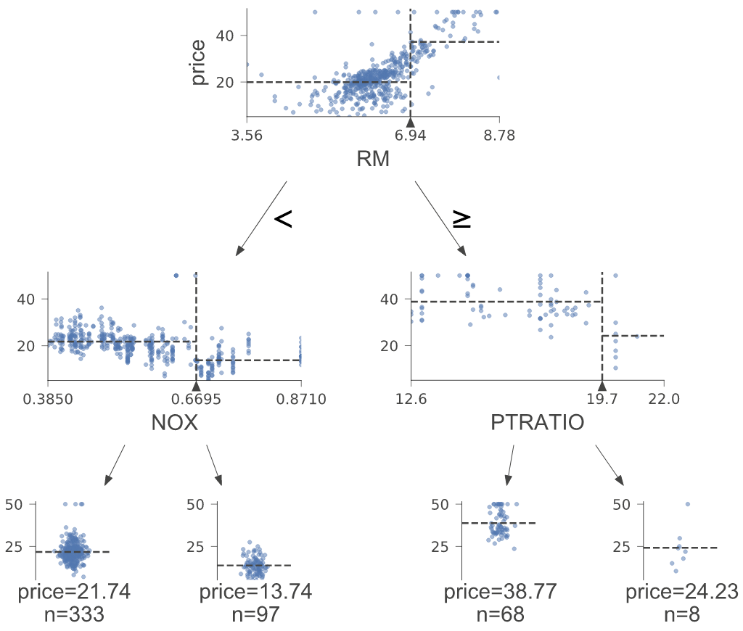
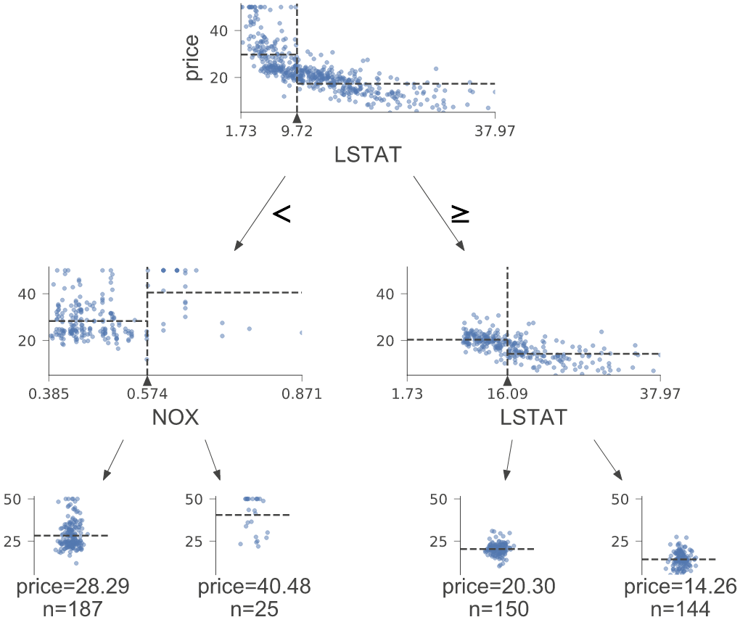
Ex: Effect of limiting feature set but using full data set
2 trees trained on entire Boston set with $m$=5 (of 13)
Choose from 5 randomly selected features during EACH split

Slide 23
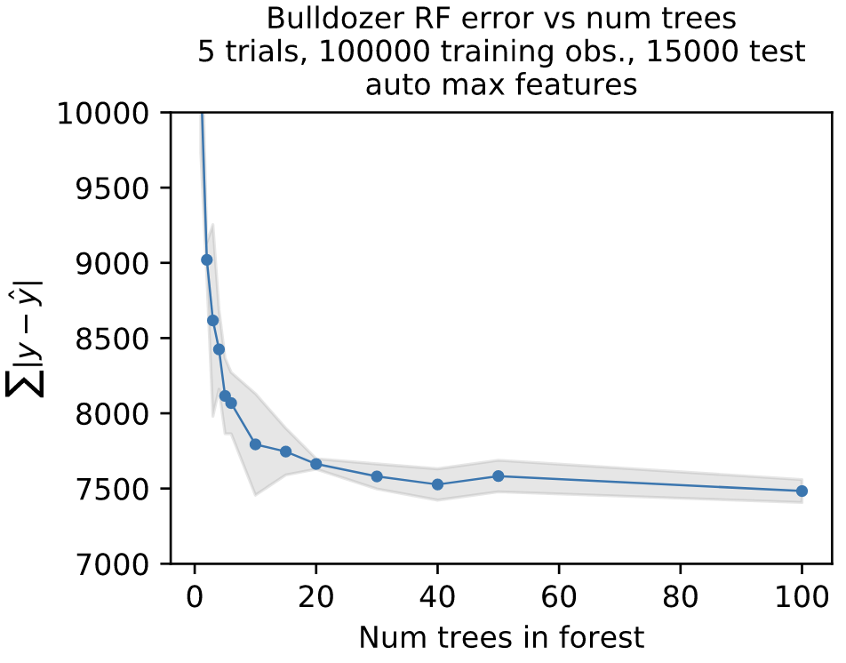
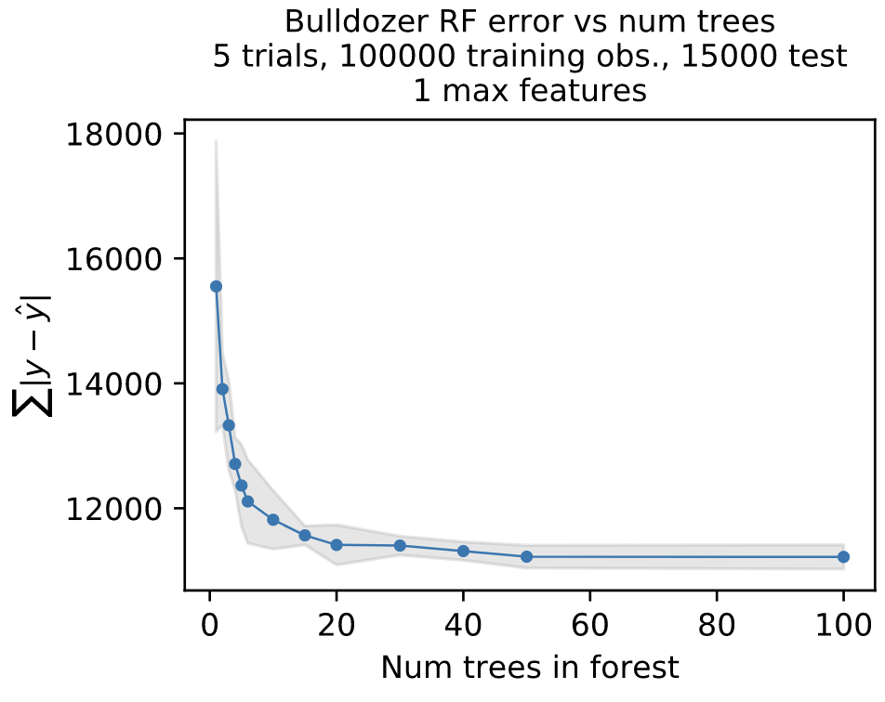
If max_features too low, bad accuracy

Slide 24
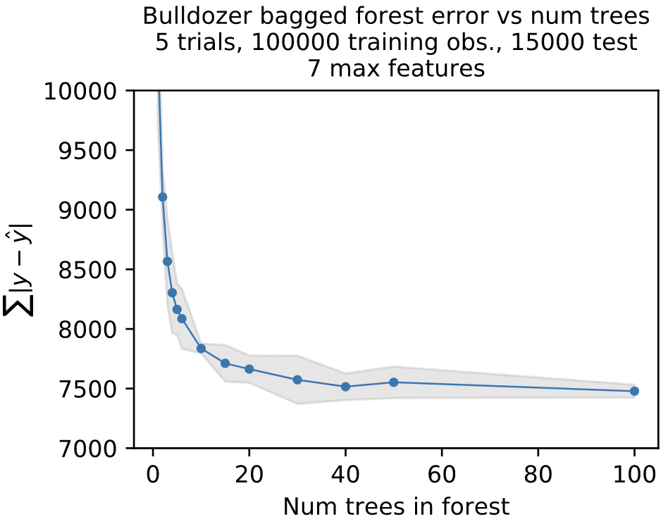
Effect of forest size on accuracy
Why does accuracy improve greatly (initially) as we add trees?
Each tree sees only 2/3 of data so adding bootstrapped trees increases use of training data
Variance is tightening quickly as we average even just a few trees
Why does accuracy asymptotically approach a minimum instead of continual improvement?
With enough trees, ensemble sees 100% of the training data; it’s approaching the accuracy of single decision tree in ideal world
We’ve squeezed out all bias and variance that we can with this model

Slide 25
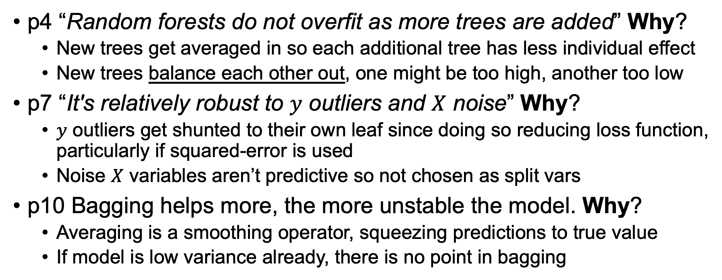
Properties (see Breiman 2001)
p4 “Random forests do not overfit as more trees are added” Why?
New trees get averaged in so each additional tree has less individual effect
New trees balance each other out, one might be too high, another too low
p7 “It's relatively robust to $y$ outliers and $X$ noise” Why?
$y$ outliers get shunted to their own leaf since doing so reducing loss function, particularly if squared-error is used
Noise $X$ variables aren’t predictive so not chosen as split vars
p10 Bagging helps more, the more unstable the model. Why?
Averaging is a smoothing operator, squeezing predictions to true value
If model is low variance already, there is no point in bagging

Slide 26
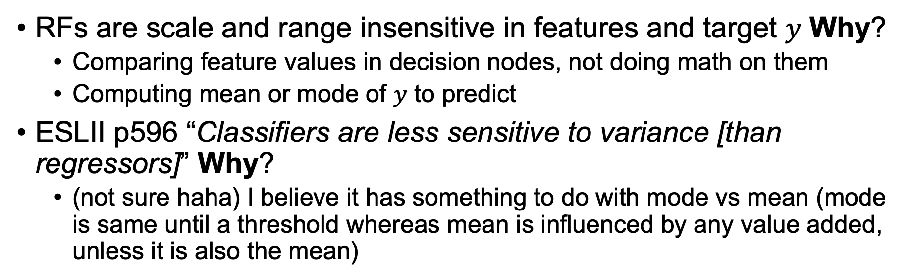
Properties continued
RFs are scale and range insensitive in features and target $y$ Why?
Comparing feature values in decision nodes, not doing math on them
Computing mean or mode of $y$ to predict
ESLII p596 “Classifiers are less sensitive to variance [than regressors]” Why?
(not sure haha) I believe it has something to do with mode vs mean (mode is same until a threshold whereas mean is influenced by any value added, unless it is also the mean)

Slide 27
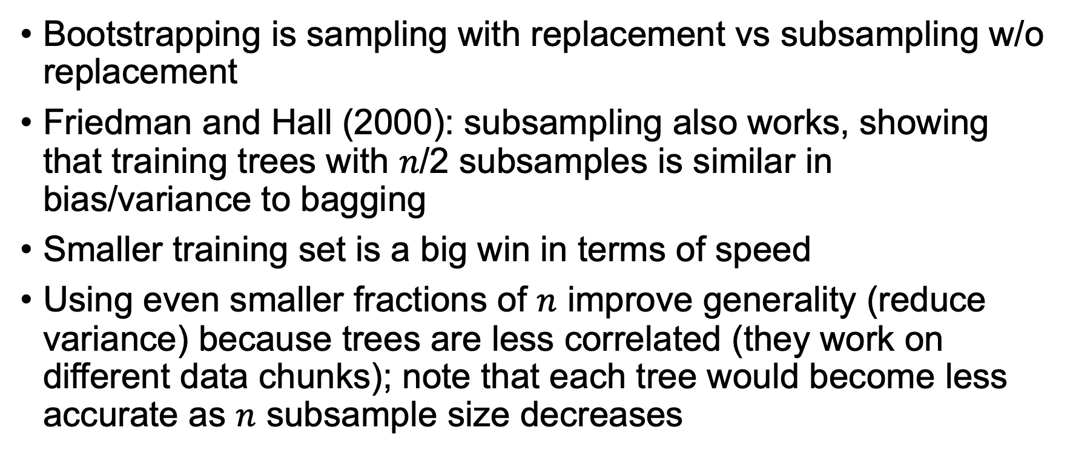
Bootstrapping vs subsampling
Bootstrapping is sampling with replacement vs subsampling w/o replacement
Friedman and Hall (2000): subsampling also works, showing that training trees with $n$/2 subsamples is similar in bias/variance to bagging
Smaller training set is a big win in terms of speed
Using even smaller fractions of $n$ improve generality (reduce variance) because trees are less correlated (they work on different data chunks); note that each tree would become less accurate as $n$ subsample size decreases
😲
http://statweb.stanford.edu/~jhf/ftp/bag.pdf

Slide 28
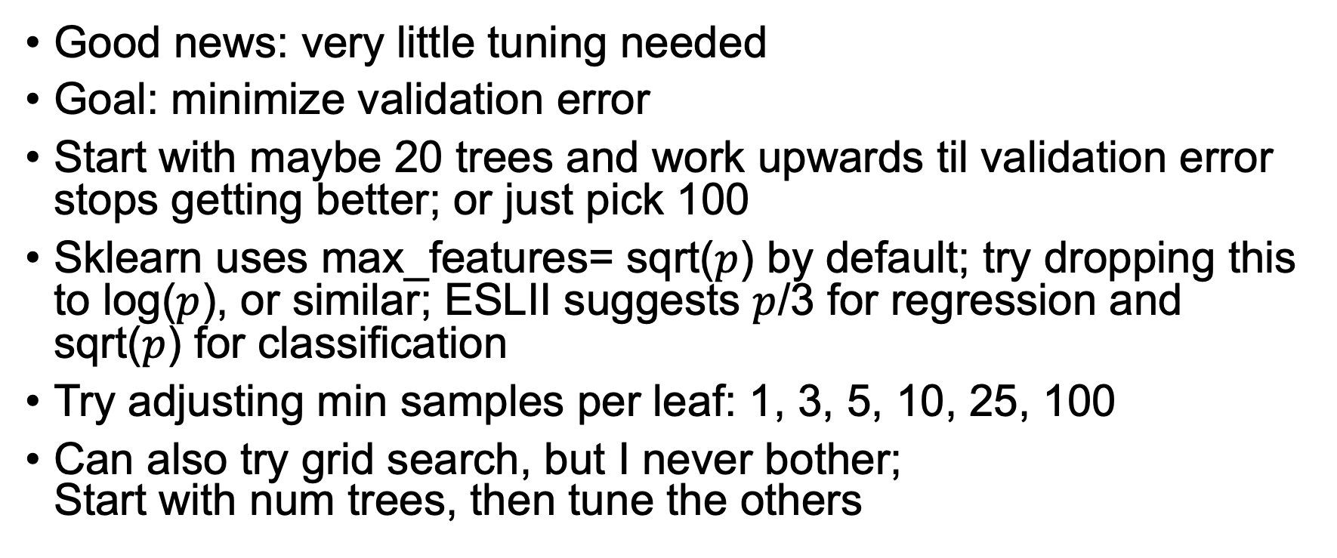
RF Tuning strategy
Good news: very little tuning needed
Goal: minimize validation error
Start with maybe 20 trees and work upwards til validation error stops getting better; or just pick 100
Sklearn uses max_features= sqrt($p$) by default; try dropping this to log($p$), or similar; ESLII suggests $p$/3 for regression and sqrt($p$) for classification
Try adjusting min samples per leaf: 1, 3, 5, 10, 25, 100
Can also try grid search, but I never bother; Start with num trees, then tune the others

Slide 29
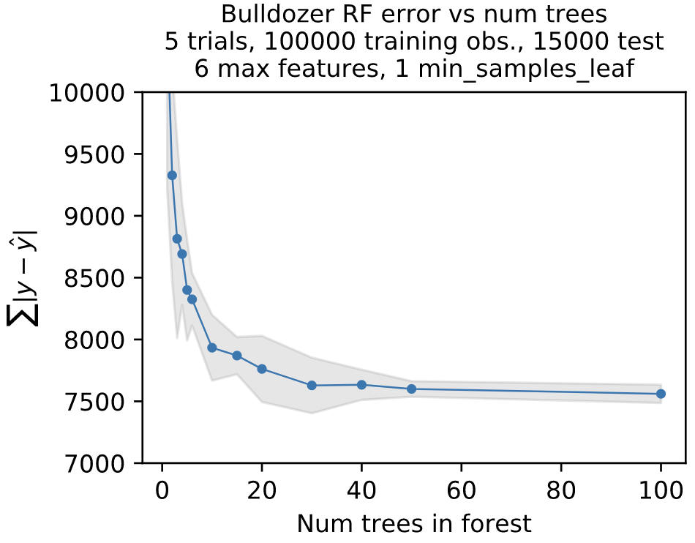
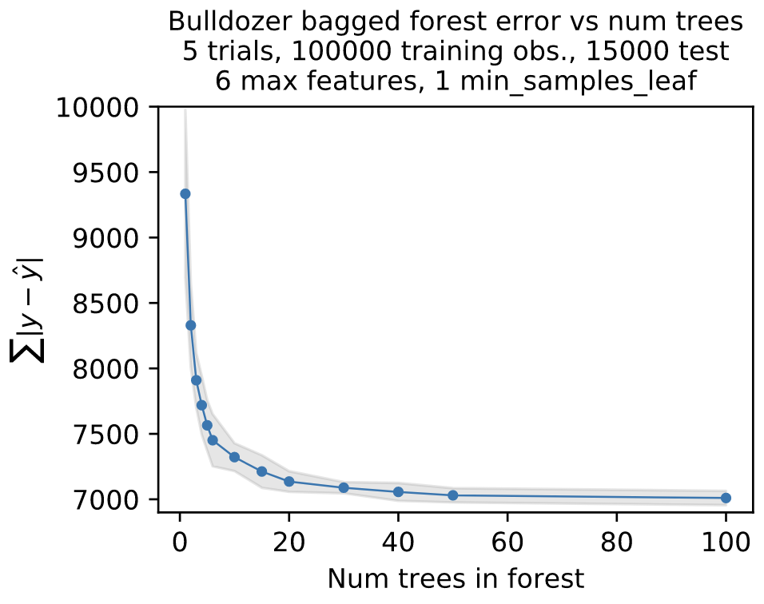
Feature engineering beats model tuning
With SalesID
SalesID: unique record ID, and is never seen again in future predictions
Is that useful for prediction? No
Does the model think it’s useful? Yes
Model is overfit not on noise but on falsely-predictive feature
Could be that sales ID correlates with inflation or change in type of models sold in auction creates “trend” in sale prices
A case where using LESS data improves the model a lot ($500 diff)
Dropping useless features also often gives a small bump
W/o SalesID

Slide 30
The RF algorithms

Slide 31
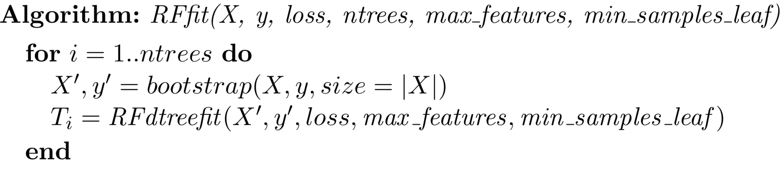
Fitting RFs
For regression, pass in loss = MSE or stddev
For classifier, pass in loss = gini

Slide 32
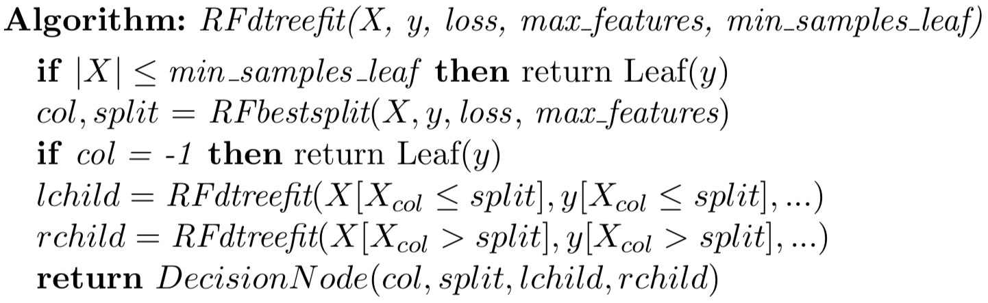
Fitting a single tree in RF
Same as decision tree except
we pass max_features to RFbestsplit()

Slide 33
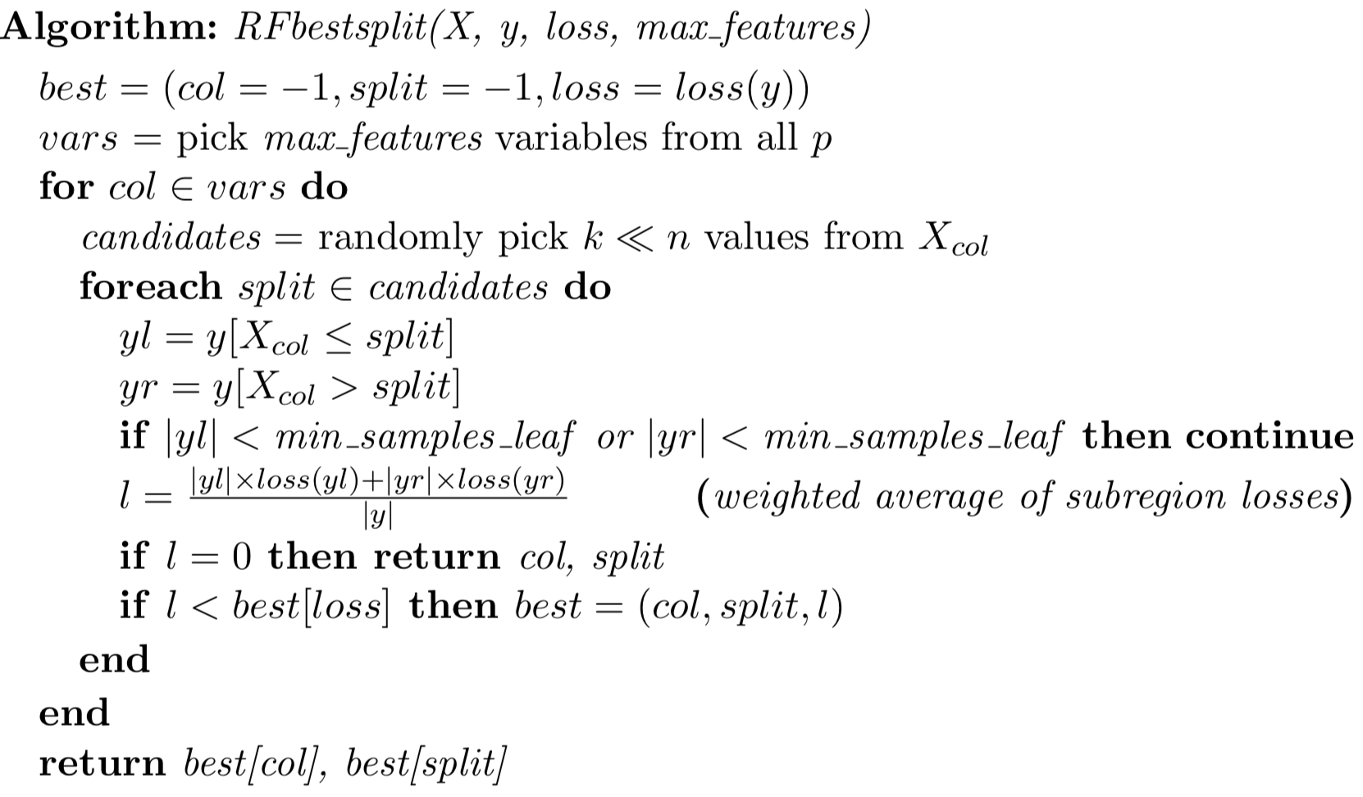
Finding best split in decision node in RF
Only diff with decision tree
Pick, say, 11 not all possible X
values. We get better generality
and code is much faster!
Should pick midpoint between
split value and next smallest X

Slide 34
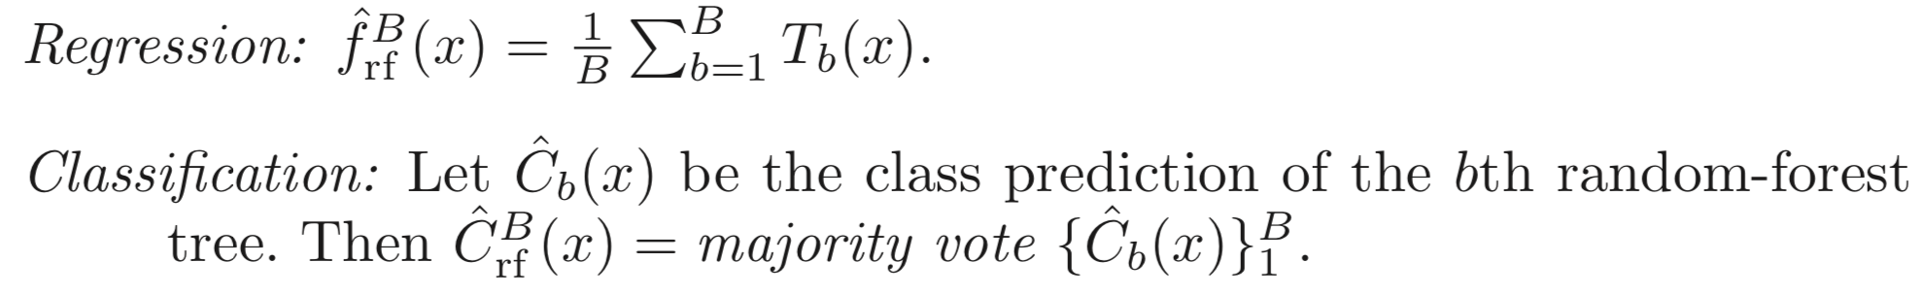
Simplest RF prediction (ESLII p588)
But doesn’t use all information to make best prediction
Should use weighted averages / votes

Slide 35
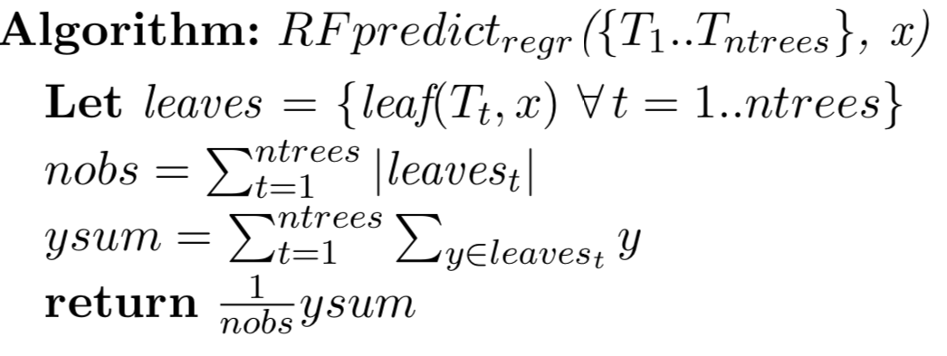
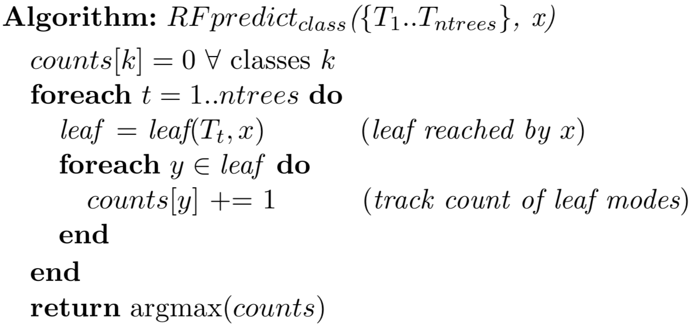
RF prediction
Weighted average of y values
among the leaves reached by
running x down each tree
Count all y votes among the leaves
reached by running x down each tree

Slide 36
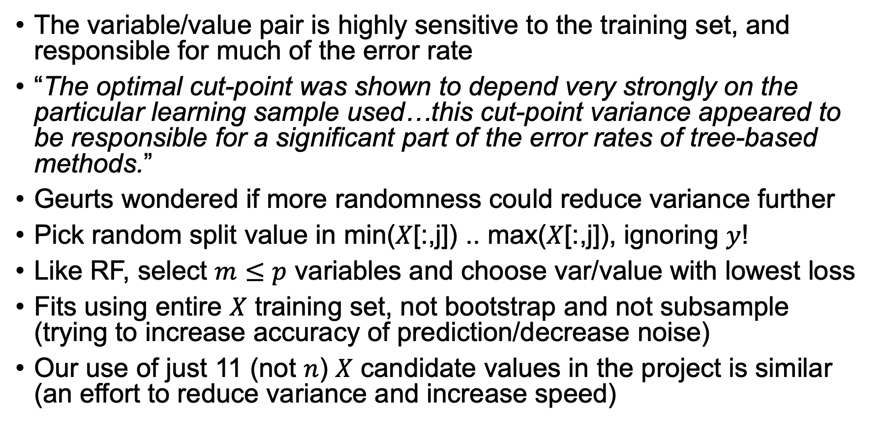
Extremely randomized trees (Geurts et al 2006)
The variable/value pair is highly sensitive to the training set, and responsible for much of the error rate
“The optimal cut-point was shown to depend very strongly on the particular learning sample used…this cut-point variance appeared to be responsible for a significant part of the error rates of tree-based methods.”
Geurts wondered if more randomness could reduce variance further
Pick random split value in min($X$[:,j]) .. max($X$[:,j]), ignoring $y$!
Like RF, select $m≤p$ variables and choose var/value with lowest loss
Fits using entire $X$ training set, not bootstrap and not subsample (trying to increase accuracy of prediction/decrease noise)
Our use of just 11 (not $n$) $X$ candidate values in the project is similar (an effort to reduce variance and increase speed)
https://link.springer.com/article/10.1007/s10994-006-6226-1

Slide 37
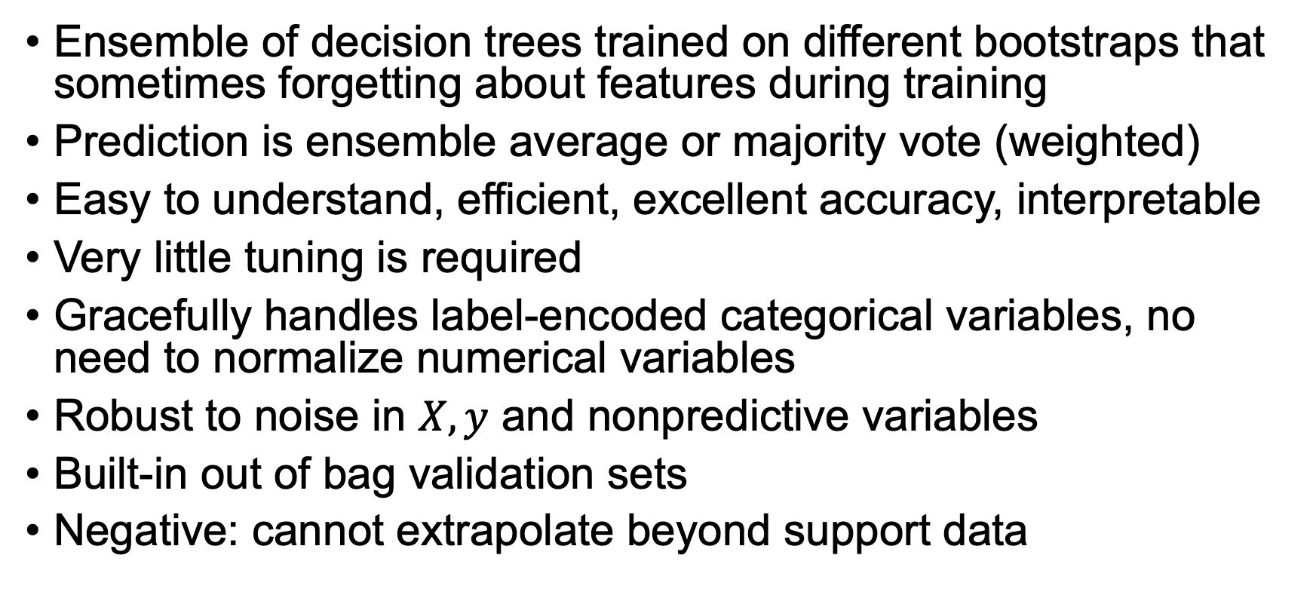
RF advantages
Ensemble of decision trees trained on different bootstraps that sometimes forgetting about features during training
Prediction is ensemble average or majority vote (weighted)
Easy to understand, efficient, excellent accuracy, interpretable
Very little tuning is required
Gracefully handles label-encoded categorical variables, no need to normalize numerical variables
Robust to noise in $X, y$ and nonpredictive variables
Built-in out of bag validation sets
Negative: cannot extrapolate beyond support data

